Slide 1
Grid R-CNN
su
2018/1207

Slide 2
Main Contributions
propose a novel localization framework called Grid R-CNN which substitute traditional regression network by fully convolutional network that preserves spatial information efficiently.
We design a multi-point supervision form that predicts points in grid to reduce the impact of some inaccurate points. We further propose a feature map level information fusion mechanism that enables the spatially related grid points to obtain incorporated features so thattheir locations can be well calibrated
We perform extensive experiments and prove that Grid R-CNN framework is widely applicable across different detection frameworks and network architectures with consistent gains. The Grid R-CNN performs even better in more strict localization criterion (e.g. IoU threshold = 0.75). Thus we are confident that our grid guided localization mechanism is a better alternative for regression based localization methods.

Slide 3
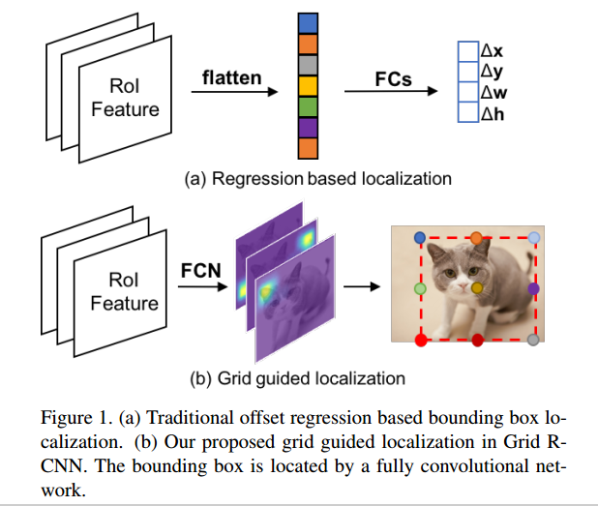
Difference
Since a bounding box has four degrees of freedom, two
independent points (e.g. the top left corner and bottom
right corner) are enough for localization of a certain object.
However the prediction is not easy because the location of
the points are not directly corresponding to the local features. For example, the upper right corner point of the cat in Figure 1.b lies outside of the object body and its neighborhood region in the image only contains background,it may share very similar local features with nearby pixels.
To overcome this problem, we design a multi-point supervision formulation. By defining target points in a gird, we have more clues to reduce the impact of inaccurate prediction of some points. For instance, in a typical 3 × 3 grid points supervision case, the probably inaccurate y-axis coordinate of the top-right point can be calibrated by that of top-middle point which just locates on the boundary of the object. The grid points are effective designs to decrease the overall deviation

Slide 4
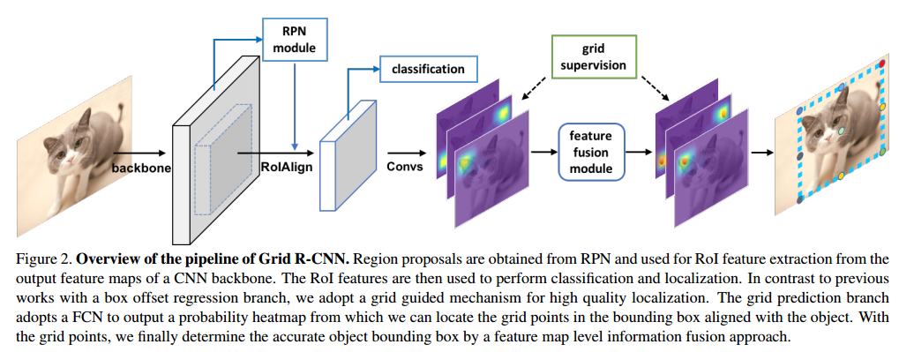
Overview of the pipeline of Grid R-CNN

Slide 5
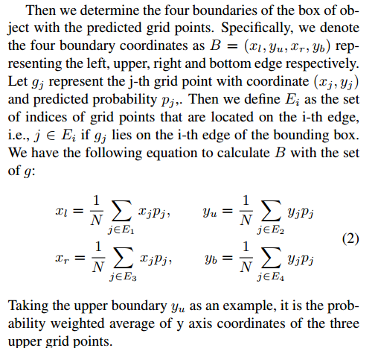
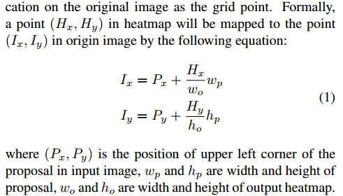
Overview of the pipeline of Grid R-CNN

Slide 6
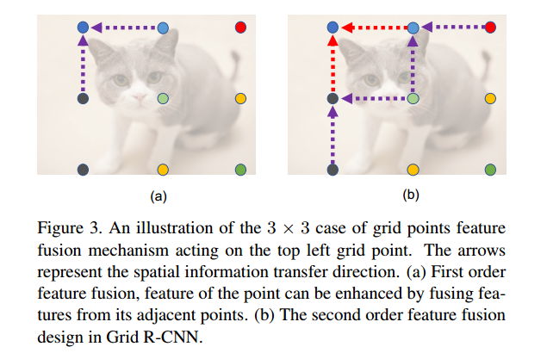
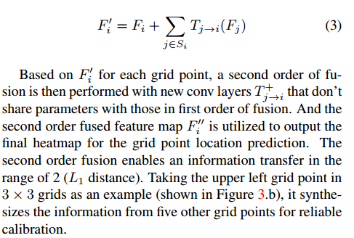
Grid Points Feature Fusion

Slide 7
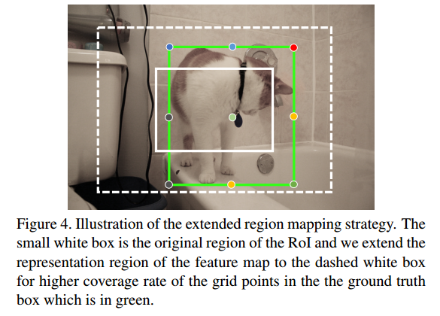
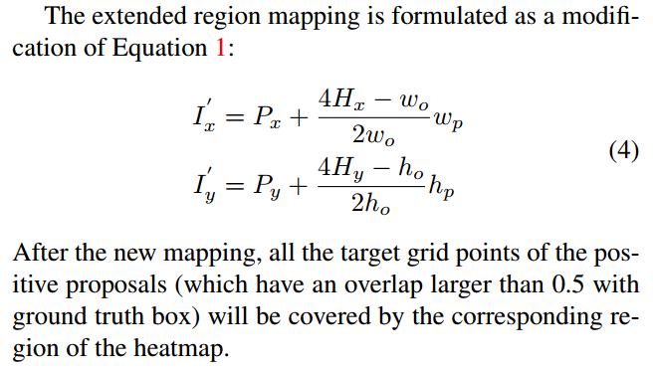
Extended Region Mapping

Slide 8
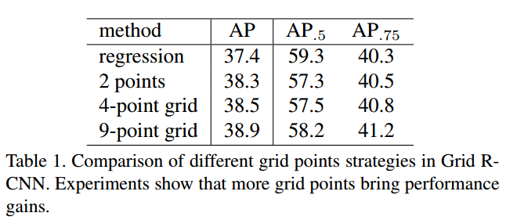
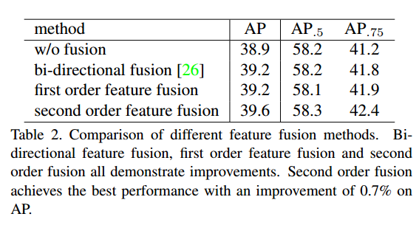
Result

Slide 9
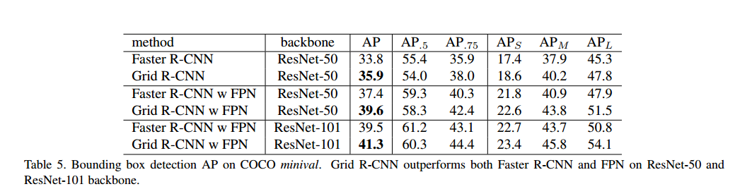
Result

Slide 10
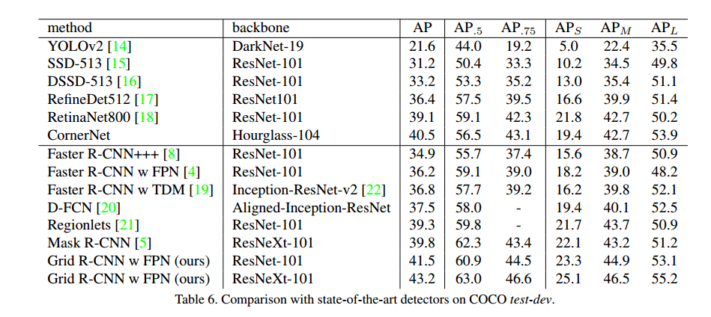
Result

Slide 11
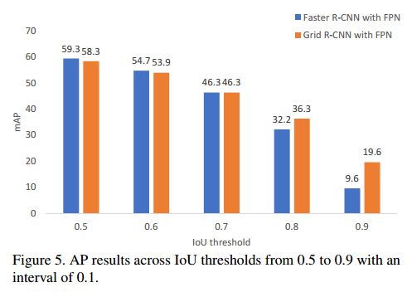
Result

